Slide 1
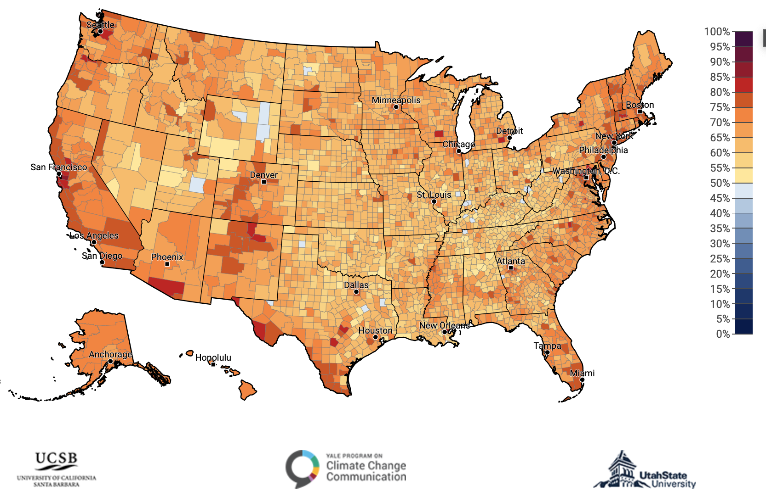

Climate Change Analysis
The Bayesian Approach
DS 6040 – Summer 2023
Abigail Snyder - syc6vs
Elena Tsvetkova - rrm3nh
Suraj Kunthu - sk9km

Slide 2



Data Set
Yale Program on Climate Change Communication & George Mason University Center for Climate Change Communication
Survey data from American adults (ages 18+) about their beliefs, attitudes, and policy opinions regarding global warming from 2008 through 2022.
Includes demographic data from the U.S. Census:
gender
race and ethnicity
level of education
Ideology and political party affiliation
Etc..

Slide 3

Data Set
Data is in categorical form and provided as a .SAV file.
In addition, there is a Survey Methods pdf which functions as a codebook for the data.
There are 30,136 observations and 54 features.

Slide 4

Problem Statement
To what extent are beliefs in climate change shaped by demographic data?

Slide 5
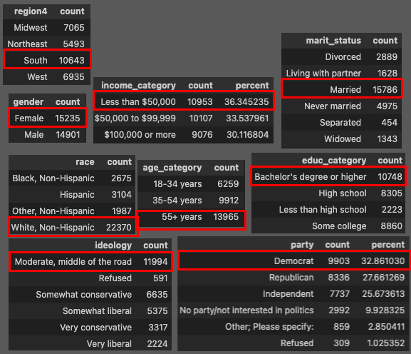
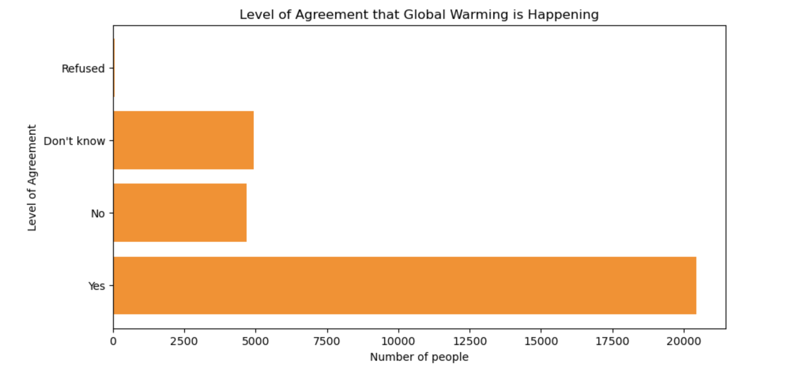
Is climate change happening?
We chose to use the survey question which examined a person's belief that climate change is happening as the response variable chosen for our models.
Most people believe climate change IS happening

Slide 6
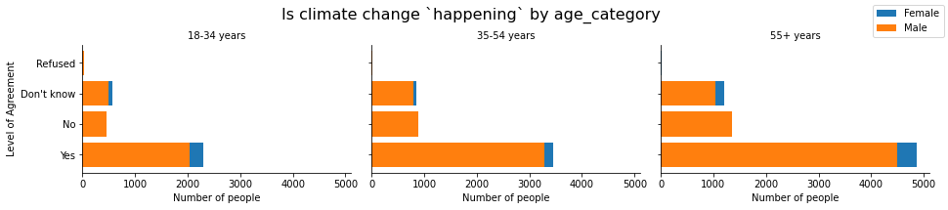
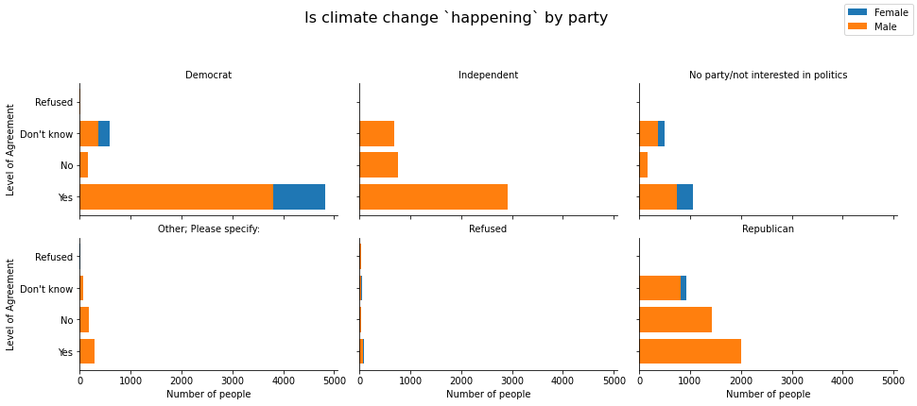
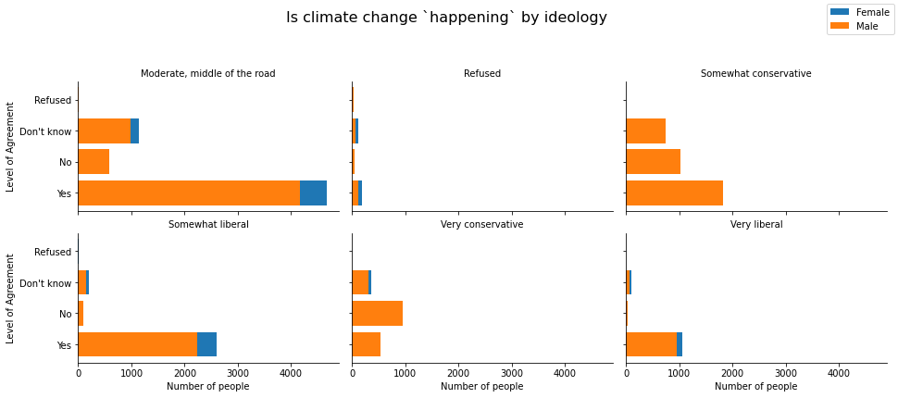
Is climate change happening?
Some interesting demographics (we utilize ideology in a later model)
Same behavior as overall chart, most people believe climate change IS happening

Slide 7


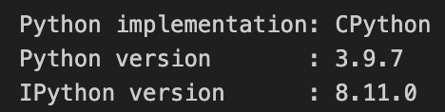


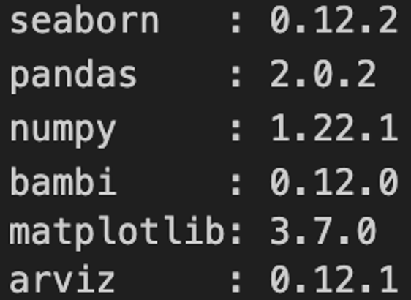




Model Design
Developed 4 Bernoulli logistic regression models
Programming Language:
Packages Involved:

Slide 8
Model Design
Based on the EDA, we trimmed down the predictor variables to those that we are most interested in: (10 out of 54)
Gender
Age category
Education category
Income category
Race
Ideology
Party
Region
Religion
Marital status
Split the data 60/40 for training and testing

Slide 9
Model Description
Model 1
Bambi default normal priors. ALL possible predictors
Model 2
Weakly informed normal priors. ALL possible predictors
Model 3
Bambi default normal priors. Select predictors (education, ideology)
Model 4
Weakly informed normal priors. Select predictors (education, ideology)
µ = 0
σ = … (bambi)
σ = 100 (weak)

Slide 10
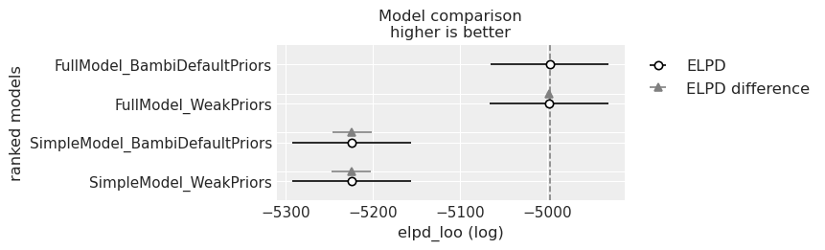
Model Comparison & Selection
Utilized Leave-One-Out Cross-Validation
Compared model performance with ELPD (expected log predictive density).
Models 1 and 2 with all predictors have a higher ELPD and perform better than the simpler model.
Both model 1 & 2 have similar ELPD -- priors do not have impact on our analysis, when using Normal priors.
We will move forward with Model 1 (all predictors, default priors)

Slide 11
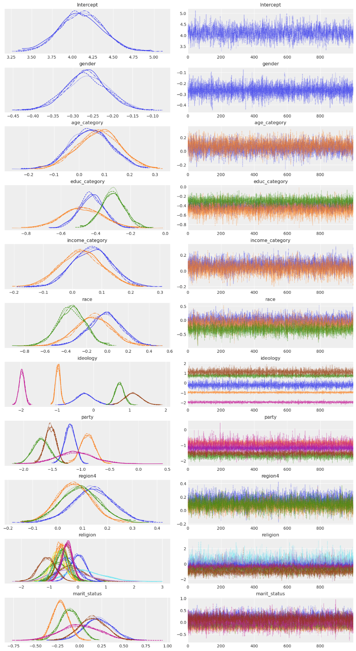
Results Some observations:
For Gender
~23% reduction in belief that global warming is happening for men compared to women.
For Education category
Completing college increases the odds that a person believes global warming is happening.

Slide 12
Results Some observations:
For Ideology
Clear pattern in ideology and climate change.
The more liberal a person is, the more likely they believe global warming is happening relative to moderates
In contrast, conservatives were much less likely to believe global warming is happening. This follows the behavior we observed during the exploratory data analysis phase.
For religion
With some variation, belief in some religion is generally associated with a decreased chance in believing global warming is happening, relative to agnostics.
For age
Little effect on whether a person believes global warming is happening (HDI’s overlap with zero).

Slide 13
Results
Separation plot of the model’s performance using test data.
The vertical lines are represented as model predictions.
Light blue is class 0 (global warming is not happening)
Dark blue is class 1 (yes, it is happening).
However, the position of the vertical lines represents the truth:
Further to the left, a person does not believe global warming
Further to the right, a person does believe it is happening.
Based on the plot, we do see light blue vertical lines towards the left and more dark blue lines to the right.
This model does a decent job at predicting whether a person believes global warming is happening or not.

Slide 14

Results and Conclusion
Some predictors, such as education, ideology, and religion, have an impact to varying degrees on whether a person believes in climate change or not. There are also predictors that have little to no impact on determining if a person believes in climate change or not.
Future studies could further explore the dataset by not only examining various modeling options but also investigating the extent to which interactions between predictors impact the overall model.
This information could be utilized to inform policymakers and educators to tailor their approach for specific demographic groups by targeting the issues they are most concerned about.
Knowing your audience can help persuade those who are not swayed by scientific facts and figures.

Slide 15
Thank you!

